Slide 1
Performance Java User's Group
For expert Java developers who want to push their systems to the next level

Slide 2
Performance JUG
Groups objectives
Discuss performance related issues and solutions for Java systems
Meet at least one a month virtually
Be accessible to developers in different time zones around the world
Record presentations to be available online later e.g. YouTube.

Slide 3
Performance JUG
The group would benefit from
more speakers
more topics
real world meetings
Suggestions and offers of help welcome

Slide 4
Performance JUG
First speaker: Peter Lawrey
Low latency design, develop and support Java trading systems for hedge funds, trading firms and investment banks.
Design systems to GC once per day or once per week (without minor collections)
First I look at the 99%tile (worst 1% of latencies) and optimise to reduce this by 10 times.

Slide 5
Peter's Principles
“Perfection is achieved, not when there is nothing more to add, but when there is nothing left to take away.”
– Antoine de Saint-Exupery French writer (1900 – 1944)
Performance shouldn't be viewed in isolation
Correctness is more important than performance
Simplicity and maintainability is generally more important than performance. You should consider these first.
Simple code tends to be optimised well and perform reasonably well.
Simple, performant code can simplify your design, be faster to write and test and be easier to maintain.
“Measure, don't guess” – Kirk Pepperdine and Jack Shirazi

Slide 6
Memory Regions in Java
On the heap and off the heap
Peter Lawrey
Higher Frequency Trading Ltd

Slide 7
Heap vs Off Heap
In Java, the main split if between the Heap and everything else which is off the Heap.
Most tuning effort is around the heap.
Poor tuning of the heap will slow your system
Well tuned => consistently good performance.

Slide 8
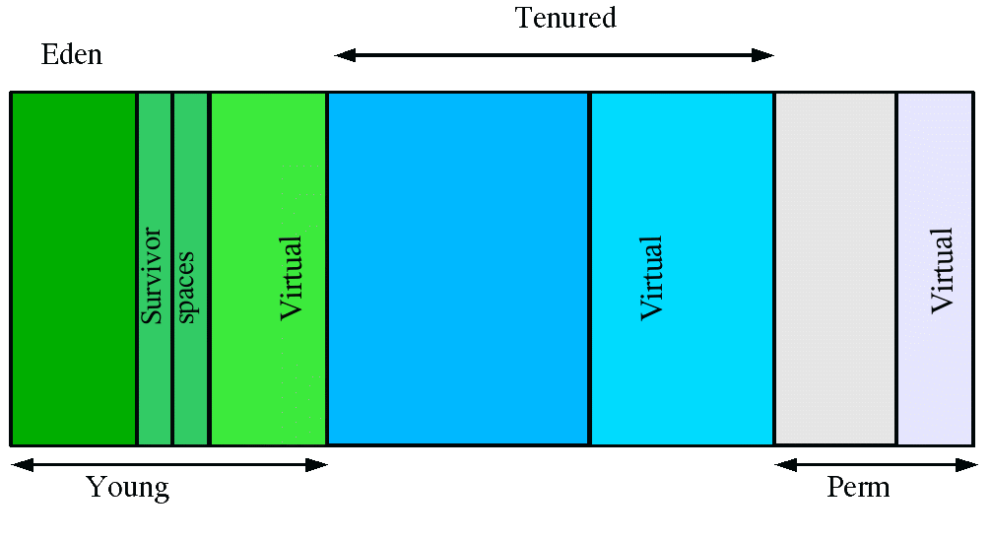
Generational Heap
The heap is split in to two regions
Young generation
Minor GC collections
Tenured generation
Major or Full collections

Slide 9
Generational Heap
The heap is split in to two regions
Young generation
Minor GC collections
Tenured generation
Major or Full collections

Slide 10
Generational Heap
Tenured Space collectors
Parallel Collector
Concurrent Mark Sweep Collector
-XX:+UseConcMarkSweepGC

Slide 11
Generational Heap - Tenured Space
Good for
Very long lived objects
Large objects
Poor for
Medium lived objects
Can lead to fragmentation
Objects which reference shorter lived objects.

Slide 12
Off Heap
These are not part of the maximum heap size.
They all add to the total memory used.
Perm Generation - going away in Java 8
Thread stack space
Shared libraries
Direct memory
Memory Mapped data

Slide 13
Off Heap
Reasons to use Off Heap memory
Little of no GC impact
Goes beyond you maximum heap size
Can be faster in some cases
Can be persisted as you write
Can be shared between processes
Main reasons not to use it
Unnatural in Java
Very low level and complicated

Slide 14
Allocating Direct Memory
You can allocate direct memory in Java with
ByteBuffer bb =
ByteBuffer.allocateDirect(size)
.order(ByteOrder.nativeOrder());
Or more directly with
long address = unsafe.allocateMemory(size);
unsafe.freeMemory(size);

Slide 15
Using memory mapped files
RandomAccessFile raf = new RandomAccessFile("filename", "rw);
ByteBuffer bb = raf.getChannel()
.map(MapMode.READ_WRITE, 0, size)
.order(ByteOrder.nativeOrder());
bb.putLong(123456);
raf.close();

Slide 16
Easier memory mapping
Chronicle chronicle = new IndexedChronicle(path);
Excerpt excerpt = chronicle.createExcerpt();
// size to reserve
excerpt.startExcerpt(1000);
// serialize your data here
excerpt.finish();
except.index(index);
// start reading the excerpt.
excerpt.finish();

Slide 17
Easier memory mapping
Java Chronicle uses
Reading or writing text logs or messages,
0.5 – 5 micro-seconds.
Reading or writing binary logs or messages,
0.1 to 1 micro-second
Lock-less use and GC less methods.
Built-in support for object pooling.

Slide 18
Demonstration
Q & A
A gateway process connects to the outside world
Processing engine, picks up events and generates it's own
Gateway and other services read the results.
The round trip is 1 - 5 micro-seconds including persistence
Replication between machines
Micro-second timestamps can record timings end to end
StackOverflow: Peter Lawrey (3rd for Java)
Blog: Vanilla Java (2+ million hits)
Library: Java Chronicle (51 forks)

Slide 19
Q & A
StackOverflow: Peter Lawrey (3rd for Java)
Blog: Vanilla Java (2+ million hits)
Library: Java Chronicle (51 forks)

